Slide 1
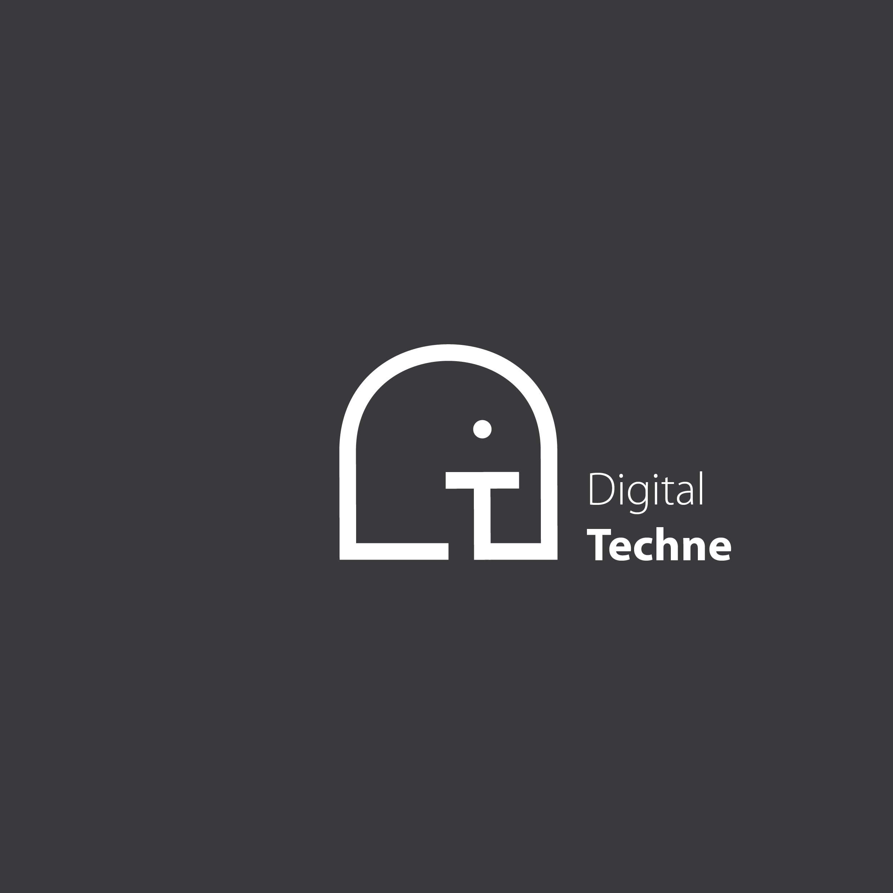
lugano web3 presentation
24/01/2024

Slide 2
The Digital Techne’s Software Platform
Physical Artwork
Genomic Tag code management
Multimedia (metadata and media files)
Confidentiality using strong crypto
Blockchain transactions (add, lend)
Digital Art
Cloning (print run, tokenization)
Marketplace integration
Blockchain transactions (add, trade)

Slide 3
Physical Artwork
The DNA code links the ink on physical artwork and its digital counterpart
Multimedia archive: easy browsing among public, private and lended dossier, holding artwork info
Confidentiality on non public dossier
Time based access to lended dossier
Personal identity and BC wallet are decoupled
Owner of the dossier can be anonymous

Slide 4
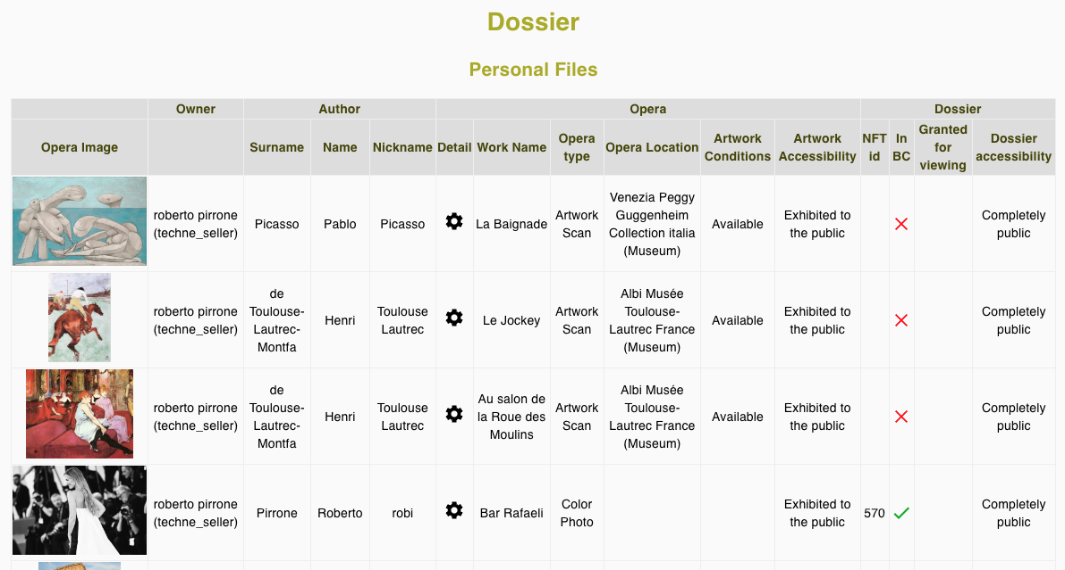
Physical Artwork

Slide 5
Digital Artwork
Streamline the easy cloning of digital artwork
Time consuming, Back End driven
Instead of attributes change (i.e. Bored Apes Yacht Club), customize each image in two possible ways:
Tokenization: split image in smaller rectangles, outline the active rectangle, blur the remaining image
Print run: imprint the number of the copy and the artist’s signature on the image

Slide 6
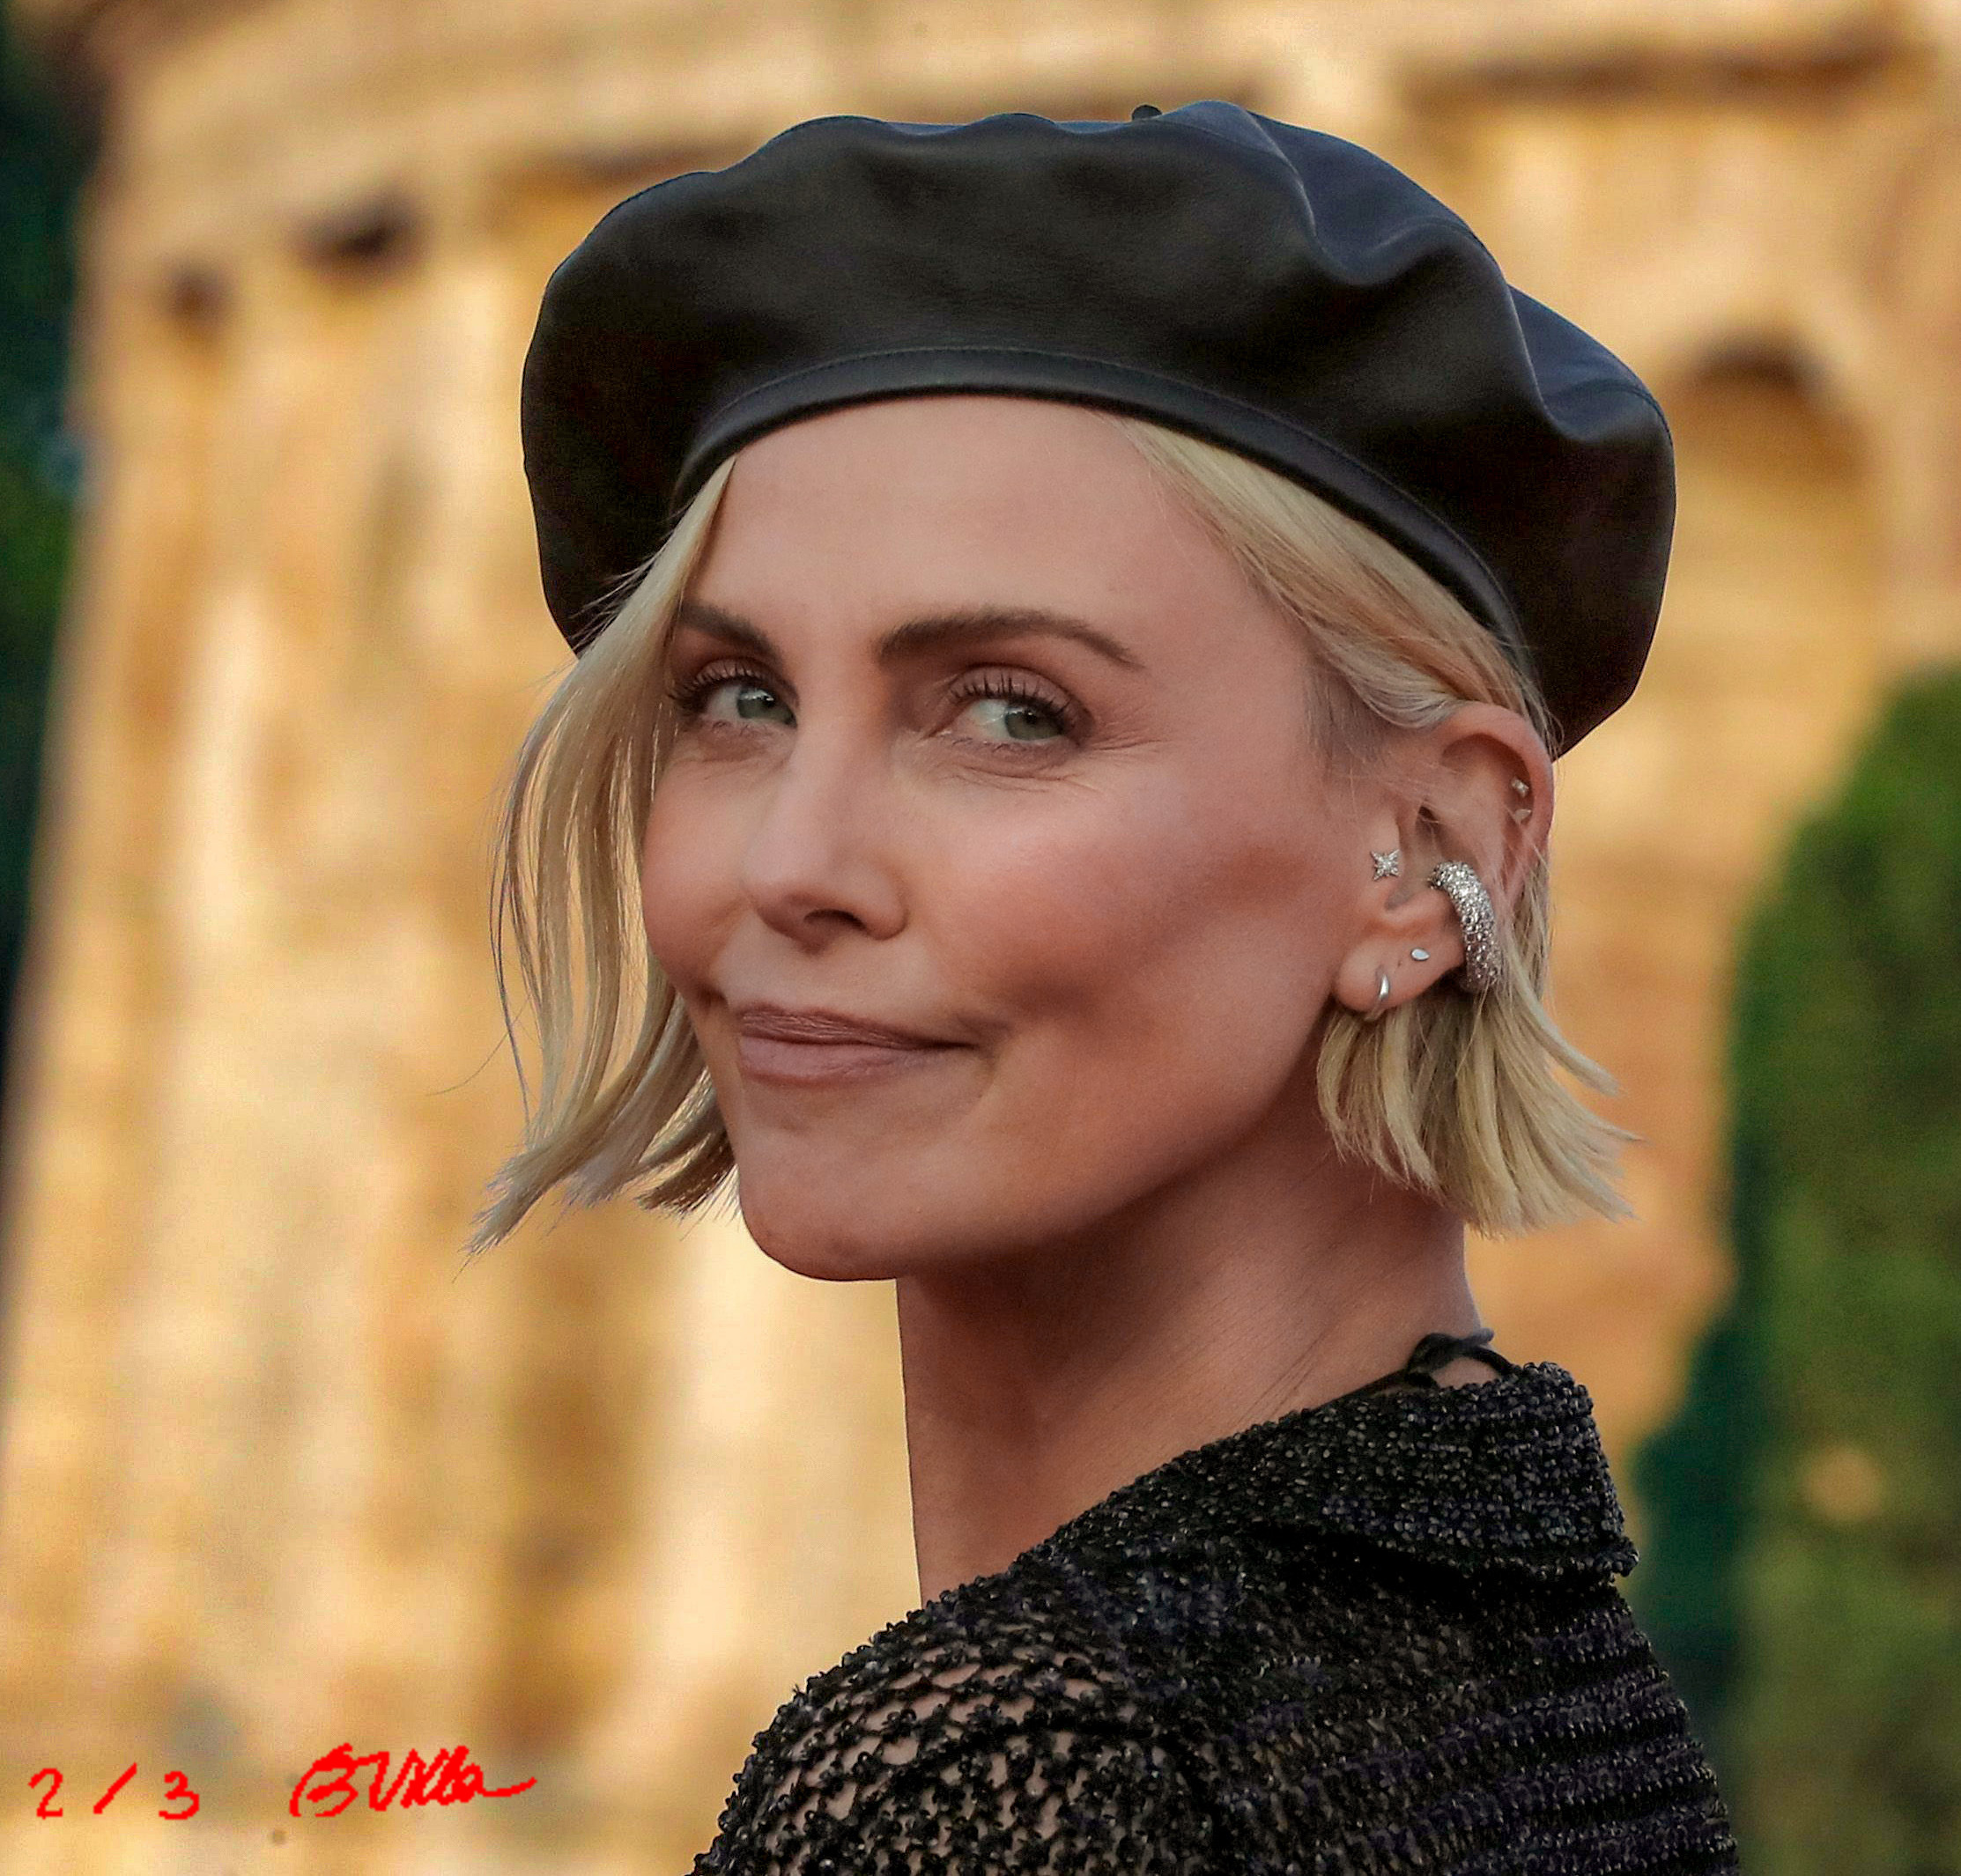
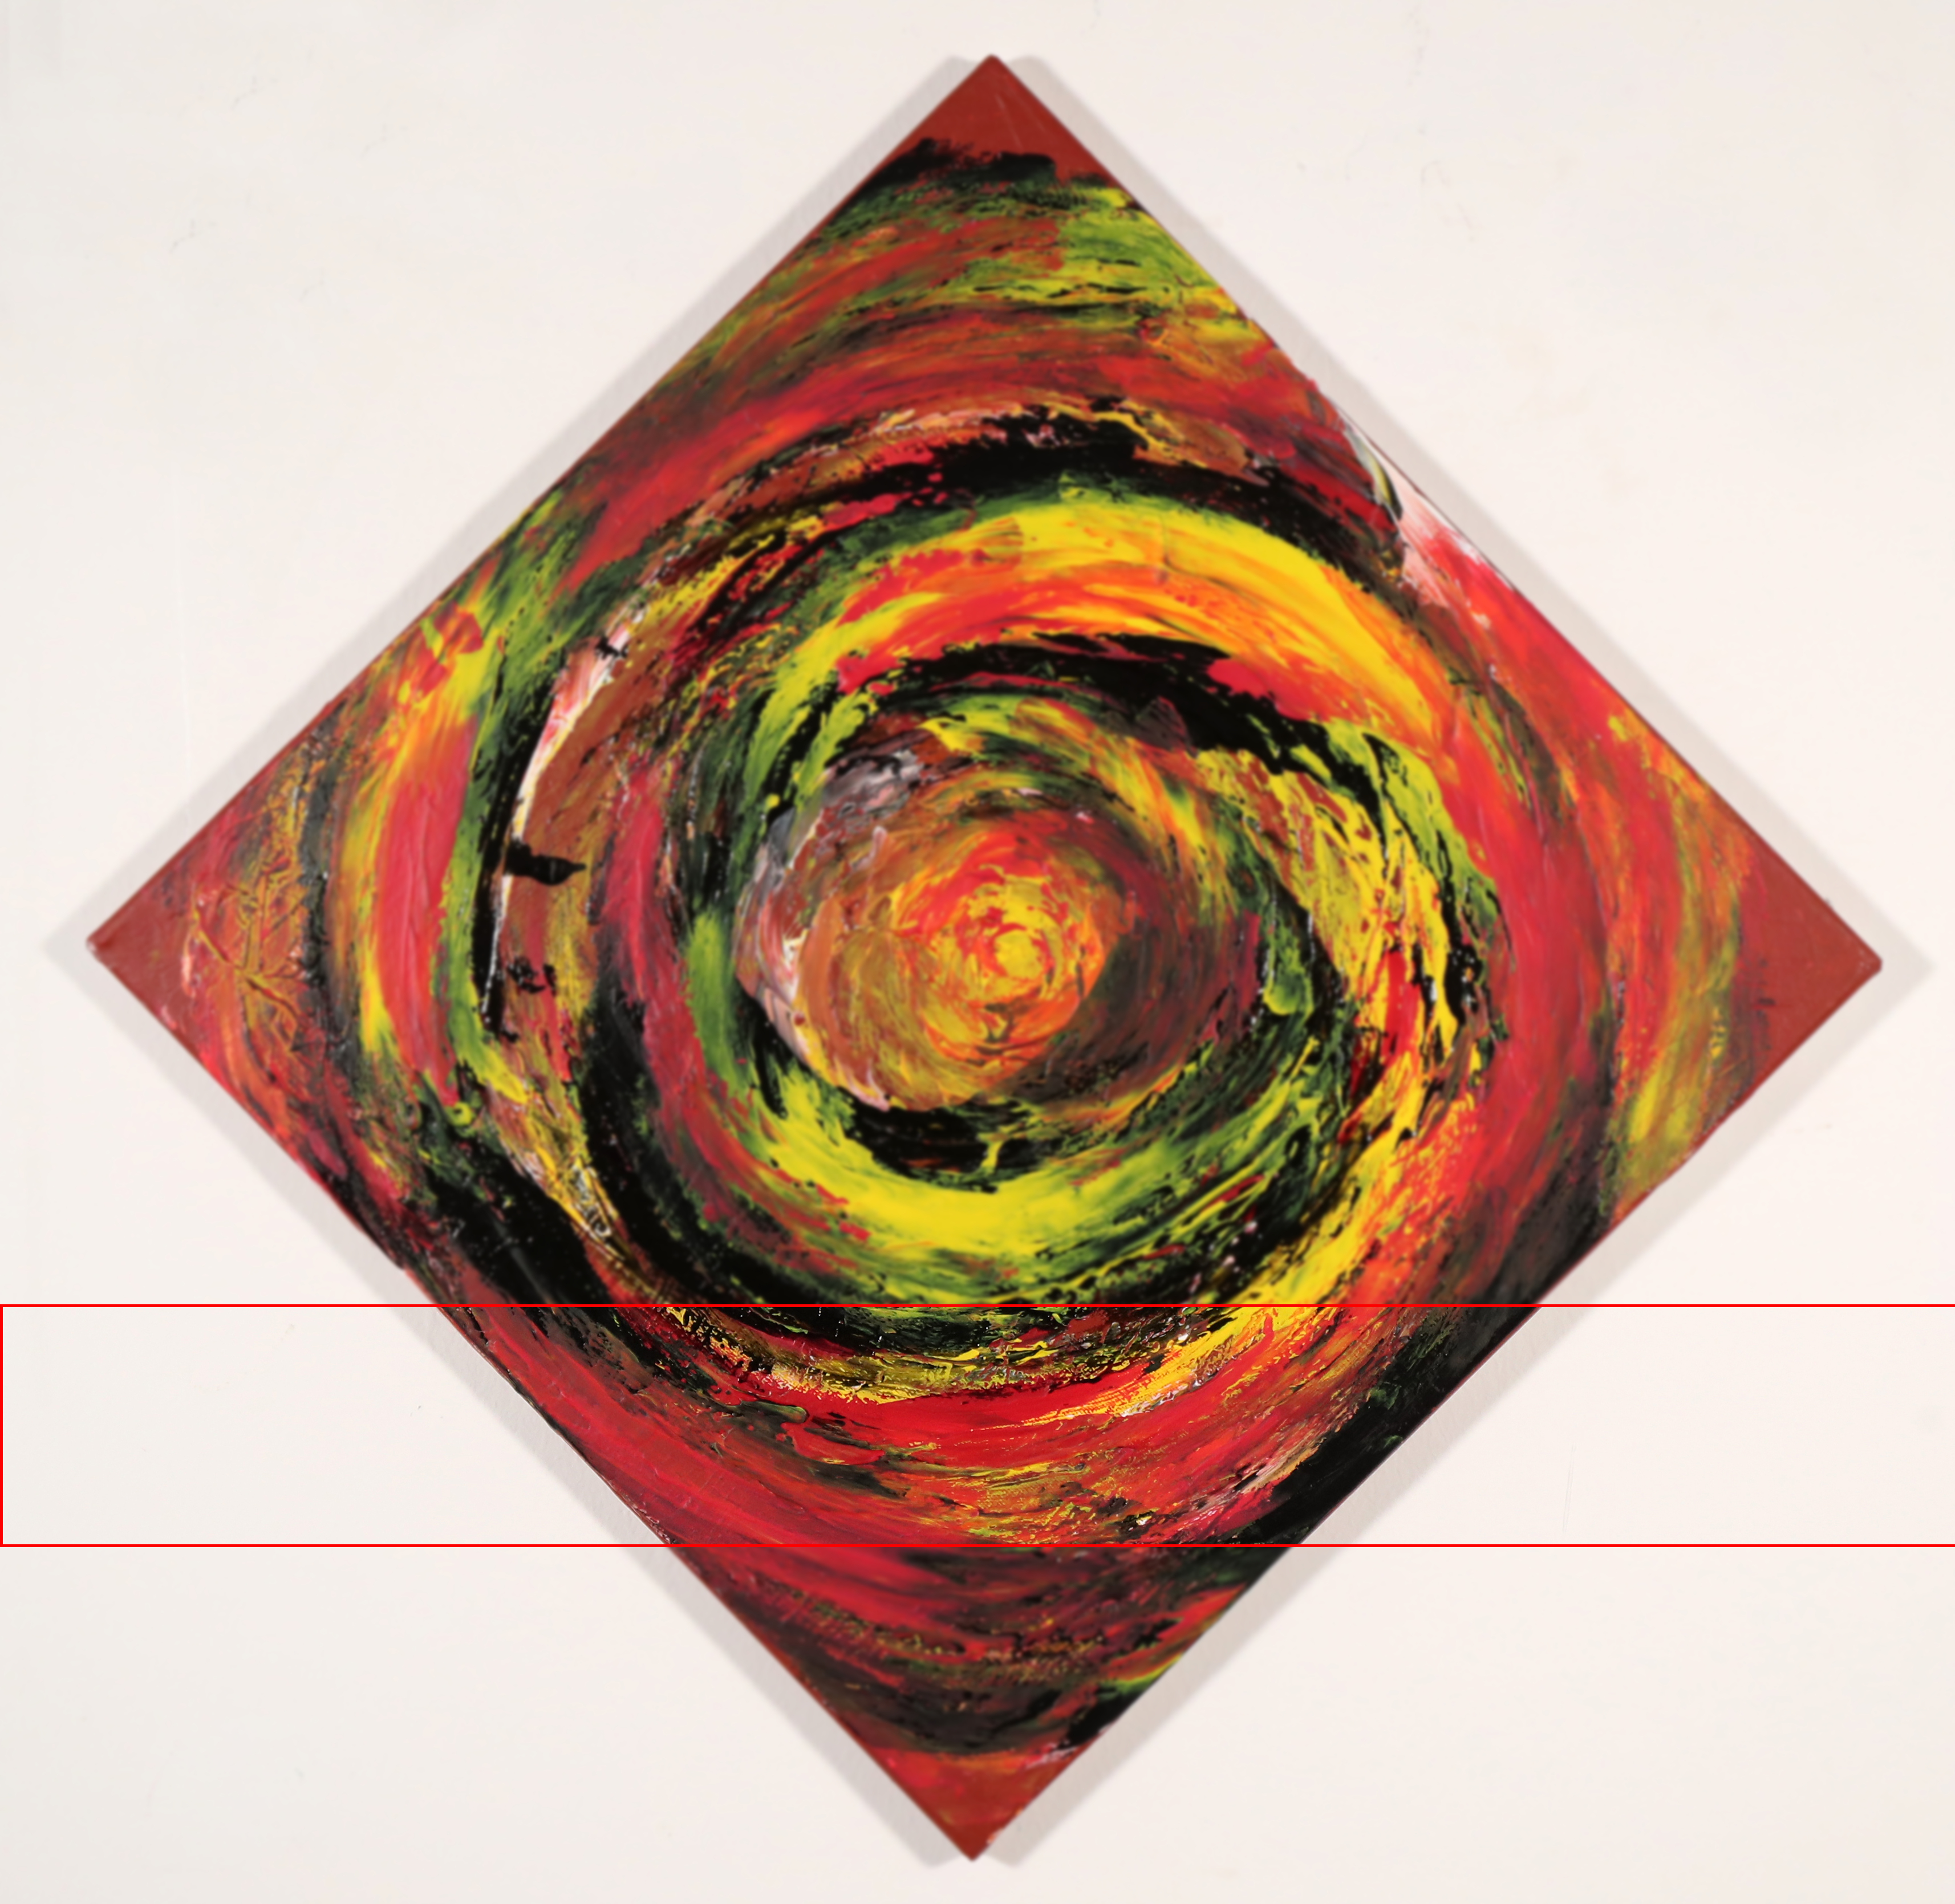
Print run and Tokenization

Slide 7
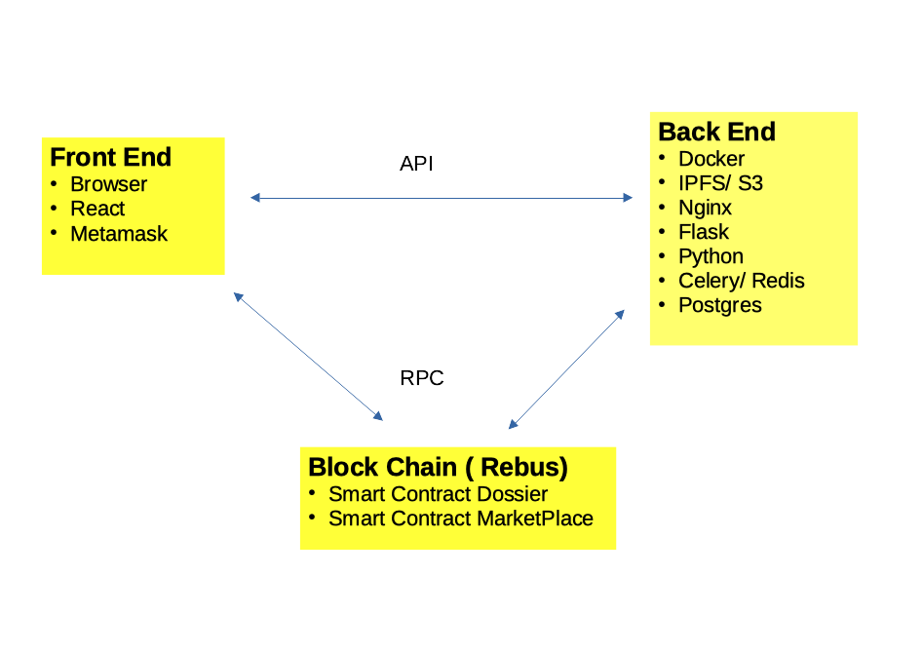
Software Structure

Slide 8
ICP Potential Benefits
More intuitive interaction for Dapp applications
Platform native integration of:
Cheap storage
Identity handling

Slide 9
Where we are
Physical Artwork
Genomic Tag POC available
Construction of the genomic laboratory and development of the software infrastructure are underway
Digital Art
Platform rel 1.0 available and already integrated with the Rebus’ marketplace
First artwork tokenization and Digital Art sale planned for the next few weeks
Market and commercial agreements
Signed agreement for several charity Digital Art sales, first one will be used to fundraise the construction of a school in Tanzania by Istituto Cottolengo
Signed agreements with some Italian artist for artwork tokenization
Signed agreements with several photo reporters
Agreements in the process of closing with UNESCO, some Art dealers and some Art collectors for the adoption of our technology
Discussion under way with the Italian government for the adoption of our technology

Slide 10

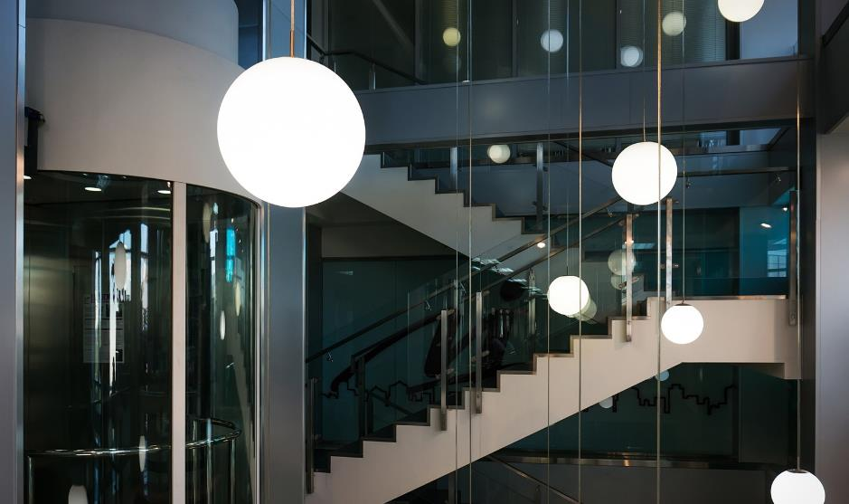
Thank you

